Slide 1
sampling
Population:
Entire group of individuals under study.
Example: Set of all students in the college.
Sample :
A small part of the population.
Example: Set of randomly selected 50 students from the college.
Statistic:
Quantity associated with sample like mean(𝑥̅), SD(s).
Example: Mean weight of 50 students from the college.

Slide 2
Sample size:
The number of units in the sample.
Large sample: Sample size 𝑛 ≥ 30.
Small sample: Sample size 𝑛 < 30.
Sampling distribution of mean:
The frequency distribution of means of different samples.
Standard error of mean:
The standard deviation of the sampling distribution of mean.
Precision:
The reciprocal of the standard error.

Slide 3
Testing of hypothesis and level of significance: test Hypothesis
Testing Hypothesis: A process to decide whether to accept or reject the hypothesis .
Null Hypothesis: Statistical hypothesis which we formulate to check whether it can be rejected .
Alternative Hypothesis: It’s the negation of null hypothesis.

Slide 4
Level of Significance.
Level of Significance: Probability below which we reject the hypothesis
called as Level of Significance.
Type 1 error: Hypothesis rejected while it should have been accepted called as Type 1 error.
Type 2 error: Hypothesis is accepted while it should have been rejected called a s Type 2 error

Slide 5
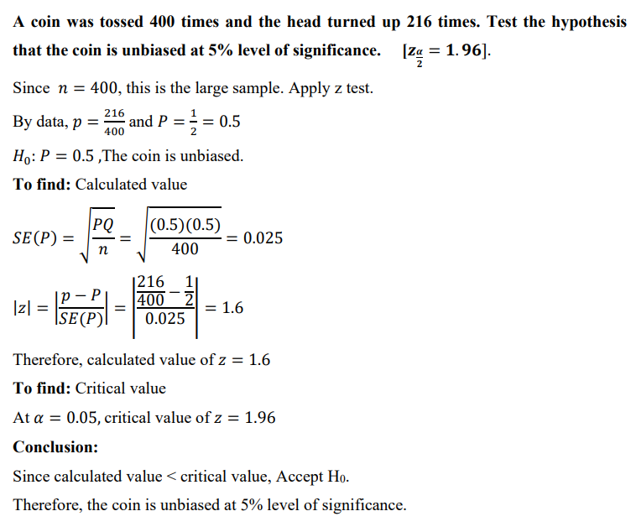
Example problem

Slide 6
Confidence limits and confidence intervals:
Acceptance Region: Region which contributes for the rejection of hypothesis is called as acceptance region .
Critical Value: The values which split the region into acceptance region and critical region.
Confidence Intervals: where the probability of population parameter will fall between 2 set of values.
Confidence Limits: Limits of the confidence intervals are called Confidence Limits.

Slide 7
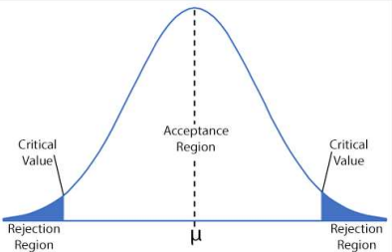

Slide 8
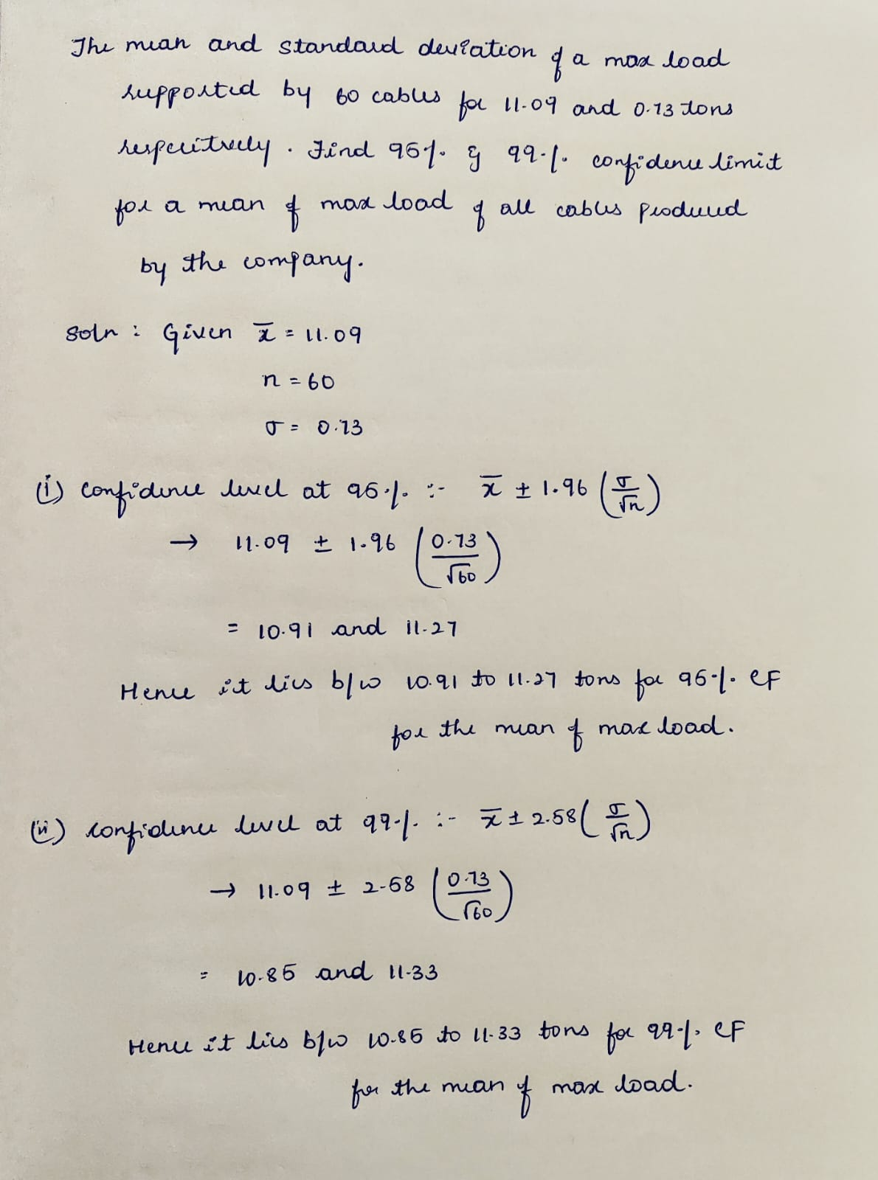
Example problem

